Slide 1
SMART SHOPPING CHART
BY-TEAM SIGNATURE

Slide 2
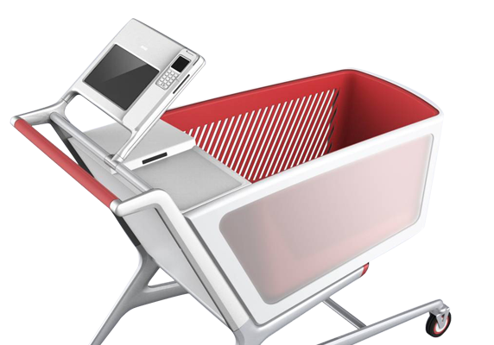
Introduction: The Automated Shopping Cart, “Smart Cart”, is an innovative consumer purchasing product that is designed to help shoppers fast-track their shopping experience

Slide 3
Advantages:
Safer shopping
Convenient shopping
A single hub for data management
An official storefront for your business
Easy payments
Shopping analytics & performance management

Slide 4
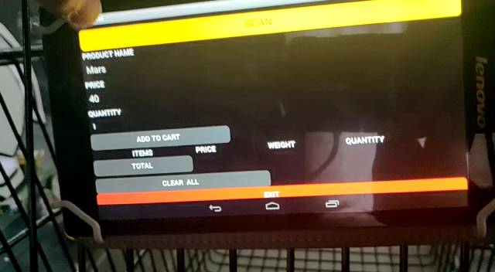
Working demo:

Slide 5
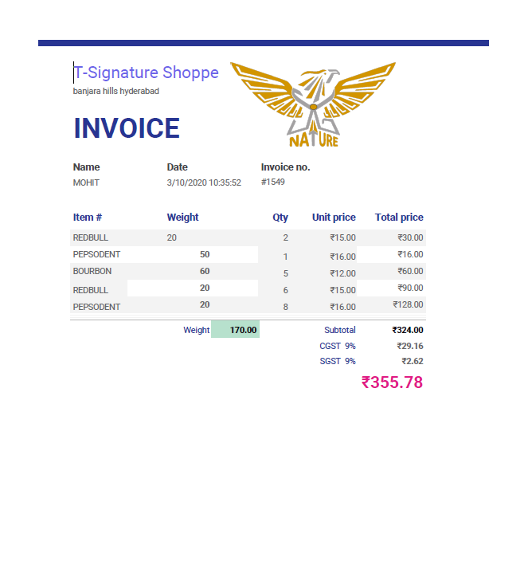
E-bill :

Slide 6
CONCLUSIONS:
smart shopping cart is implemented in such a way that it allows the customer to scan the item that he/she wants to purchase and automatically updates the bill thus preventing long queues at the checkout.

Slide 7
Thank you

